Slide 1

DIGITAL TECHNIQUES & MICROPROCESSOR (DTM -22323)
#Education with Values
#Education with Values
Department of Computer Engineering School of Polytechnic and Skill Development

Slide 2

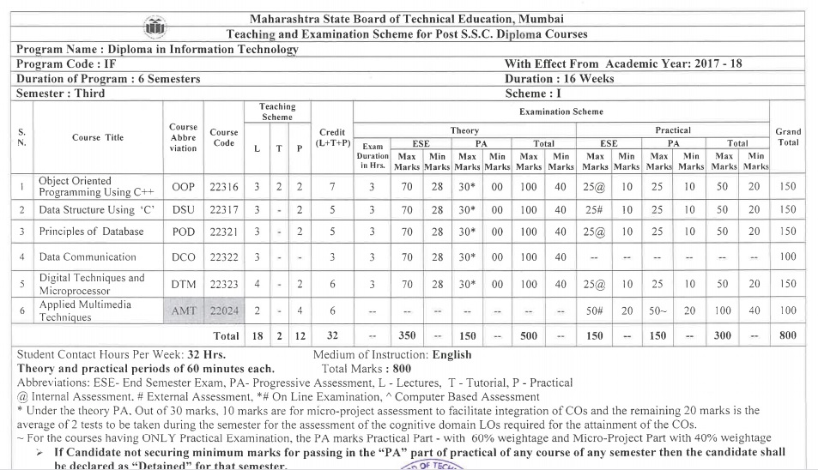
Course Contents
#Education with Values
Department of Computer Engineering School of Polytechnic and Skill Development

Slide 3
Structure
Teaching scheme |  |  | Credits (L+T+P) | Examination Scheme
L | T | P |  | Theory |  |  |  |  |  |  | Practical
4 | - | 2 | 6 | Paper (Hr.) | ESE |  | PA |  | Total |  | ESE |  | PA |  | Total
 |  |  |  | 3 | Max | Min | Max | Min | Max | Min | Max | Min | Max | Min | Max | Min
 |  |  |  |  | 70 | 28 | 30 | 0 | 100 | 40 | 25@ | 10 | 25 | 10 | 50 | 20
#Education with Values
Department of Computer Engineering School of Polytechnic and Skill Development

Slide 4
Course Outcomes
Test the Digital Systems, Logic Families and Logic Gates.
Construct combinational logical circuit.
Construct sequential logical circuit.
Use registers and instructions of 8086.
Develop assembly language programs using 8086.

Slide 5
Course Contents
UNIT-1: Number systems Digital logic families and Logic gates: (16 Marks)
1.1 Terms – Bit, Byte, Nibble
1.2 Number system: Decimal, Binary, Octal, Hexadecimal and their conversations from one number systems to another
1.3 Codes – BCD, Gray, ASCII, EBCDIC
1.4 Binary Arithmetic: Addition, Subtraction, Multiplication, Division, 1’s And 2’s Complement Method.
1.5 Applications of digital circuits, Comparison of TTL, CMOS, ECL, Characteristics of digital ICs.
1.6 Basic gates(AND, OR, NOT), Derived gate(NAND, NOR, EX-OR, EX-NOR), Universal gates.
1.7 Basic logic operations using laws of Boolean algebra. DE Morgan’s Theorems.
Unit -2: Combinational Logic Circuits : (14 mark)
2.1 Standard / canonical forms for Boolean functions, Min terms and Max terms.
2.2 Simplification by logic circuits by way of Sum – of – product (SOP) and Product-of-Sum(POS) approaches.
2.3 Expression simplification by Boolean algebra techniques (i.e K- MAP of 2,3,4 Variables)
2.4 Construction of half adder Half subtractor using K-MAP.
2.5 Necessity, principle and types of multiplexer and demultiplexer.
UNIT-3: Sequential logic circuit: (12 mark)
3.1 Combinational and Sequential logic Circuits. Block diagram of sequential circuit.
3.2 Flip – flops : one bit memory cell symbol applications of flip flops, Types of Triggering flip flops - Edge and level trigger
3.3 Principles of different flip flops : SR, JK, D & T Flip flops.
#Education with Values
Department of Computer Engineering School of Polytechnic and Skill Development

Slide 6
Course Contents
Unit -4: Microprocessor 8086 and Modern Microprocessors: (12 marks)
4.1 Evolution of microprocessor and type, 16-bit Microprocessor-8086.
4.2 Features of 8086, pin diagram and architecture of 8086, Flag register of 8086, Minimum mode and Maximum mode operation. Timing diagram. Concept of memory segmentation and pipelining, physical address generation.
4.3 Overview of Pentium family and processors.
4.4 Characteristics of RISC processor.
4.5 CISC with RISC in terms of Instruction set, Length, Addressing modes.
Unit -5: Assembly Language Programming using 8086 : (16 marks)
5.1 Programming model of 8086 assembly language program.
5.2 Addressing modes of 8086 with examples.
5.3 Group of instruction set- Data transfer, Arithmetic and Logical, Branch and loop, Flag manipulation, Shift and rotate string instructions.
5.4 Assembly language programs for ( 8 bit and 16 bit) Addition, Subtraction, Multiplication, Division, Decision making and looping.
#Education with Values
Department of Computer Engineering School of Polytechnic and Skill Development

Slide 7

Assessment Scheme
Theory Assessment (TH PA) (30Marks)
UT1 | UT2 | AVG (UT1 and UT2) | Micro Project | Total
20 | 20 | 20 | 10 | 30
Laboratory Assessment (PR PA) (50 Marks)
Term Work | End Term Exam | Total
25 | 25@ | 50
#Education with Values
Department of Computer Engineering School of Polytechnic and Skill Development

Slide 8
UNIT-III Sequential Logic Circuit(18 marks)
#Education with Values
Department of Computer Engineering School of Polytechnic and Skill Development

Slide 9
UNIT-III Sequential Logic Circuit 4.1 Basic memory cell-RS –latch using NAND and NOR 4.2 Triggering Methods- Edge and level trigger 4.3 SR Flip Flops-S R flip flop, clocked flip flop with set and clear, drawbacks of SR flip flop 4.4 JK Flip flops –Clocked JK flip flop , Race around condition, master slave JK flip flop , T and D type flip flop excitation table of flip flop, IC 7474, IC 7475. 4.5 Shift Register-logic diagram of SISO, SIPO,PIPO, PISO shift register. 4.6:Counters- Asynchronous and synchronous up/down counter decade counter
#Education with Values
Department of Computer Engineering School of Polytechnic and Skill Development

Slide 10
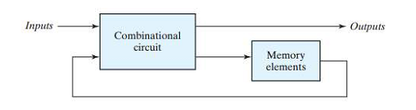
Sequential Circuit
sequential logic circuit is a type of logic circuit whose output depends not only on the present value of its input signals but on the sequence of past inputs, the input history as well.
In other words, the output state of a “sequential logic circuit” is a function of the following three states, the “present input”, the “past input” and/or the “past output”.
#Education with Values
Department of Computer Engineering School of Polytechnic and Skill Development

Slide 11
Comparison of combinational and sequential circuits
Parameter | Combinational circuit | Sequential circuit
Output depends on | Input present at that instant of time | Present inputs and past input/outputs
Memory | Not necessary | Necessary
Clock input | Not necessary | Necessary
Construction | Easier to design | Complex to design
Working speed | Faster | Slower in speed
Examples | Adders, subtractors, multiplexers ,demultiplexers | Flip Flops , shift registers, counters
#Education with Values
Department of Computer Engineering School of Polytechnic and Skill Development

Slide 12
Basic(1Bit) memory cell
The basic digital memory circuit is known as Flip-Flop.
it has two stable states 1 state and 0 state.
it consist of two inverters 1 and 2.the output of 1st is connected to input of 2nd and output of 2nd is connected to input of 1st
#Education with Values
Department of Computer Engineering School of Polytechnic and Skill Development

Slide 13
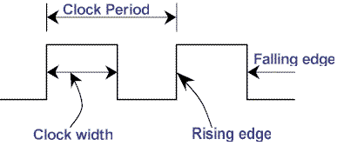
Clock Signal
This signal is called as timing signal
Every sequential circuit will have this timing signal applied as input signal
Clock signal is 50% duty cycle signal which means its ON time is equal to its OFF time.
This clock signal repeats itself after every T seconds hence clock frequency is f=1/T
#Education with Values
Department of Computer Engineering School of Polytechnic and Skill Development

Slide 14
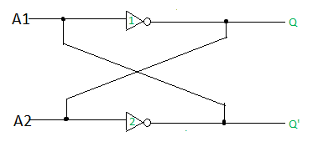
Basic(1Bit) memory cell
The output Q and Q’ are always complementary.
The circuit has two stable state. one of them is Q=1 and Q’=0 and it is called set state or 1state.
Other sate is Q=0 and Q’=1 and it is called reset state or 0 state.
if the circuit is in set state it remain in that state and if it is in reset state then it will continue to be in reset state. This property of the circuit shows that it can store 1 bit of digital information therefore it is called as a1bit memory cell
#Education with Values
Department of Computer Engineering School of Polytechnic and Skill Development

Slide 15
The information is latched in this circuit therefore this circuit is also called as Latch
The latches can be classified in to two types
SR latch using NOR gates
SR latch using NAND gates
#Education with Values
Department of Computer Engineering School of Polytechnic and Skill Development

Slide 16
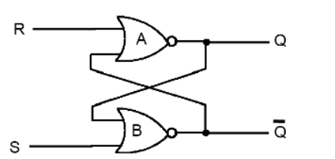
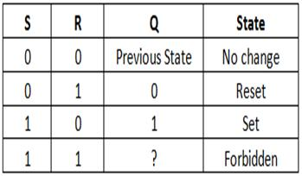
RS latch using NOR gate
NOR gate output goes to “0”when any one input become high
#Education with Values
Department of Computer Engineering School of Polytechnic and Skill Development

Slide 17
RS latch using NOR gate
If S=0 and R=0
If 0’s are applied both S and R simultaneously the latch is in in unchanged mode state and retain the binary state previously stored in to it.
If S=0 and R=1
The output of first NOR gate Q become 0.S is already 0 hence both input to Second NOR gate are 0 hence output =1 . This called Reset mode of operation.
If S=1 and R=0
The output of second NOR gate become 0.R is already 0 hence both input to First NOR gate are 0 hence output Q=1 . This called set mode of operation.
If S=1 and R=1
if 1 is applied to the both gate input simultaneously then the output of both NOR gate will try to become 0 at he same time. this is not acceptable because both output should be complementary to each other. therefore this state should be avoided. So latch is in forbidden mode.
#Education with Values
Department of Computer Engineering School of Polytechnic and Skill Development

Slide 18
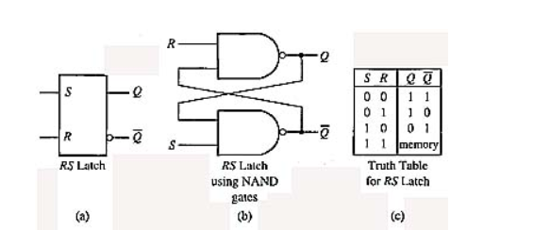
RS latch using NAND gate
When any one input of a NAND gate becomes 0,its output is forced to 1
#Education with Values
Department of Computer Engineering School of Polytechnic and Skill Development

Slide 19
RS latch using NAND gate
If S=0 and R=0
If 0’s are applied both S and R simultaneously then Q and l both will be forced to be 1. this is undetermined state and should be avoided. This is also called as race condition.
If S=0 and R=1
S=0 forces =1 hence both input to first NAND gate are 1. so Q=0.This called Reset condition.
If S=1 and R=0
since R=0, Q is forced to 1nhence both input to Second NAND gate are 1 hence =0. This called set mode of operation.
If S=1 and R=1
if 1 is applied to the both gate input simultaneously then the output of both NAND gate will not change .latch is in Unchanged mode.
#Education with Values
Department of Computer Engineering School of Polytechnic and Skill Development

Slide 20
Triggering methods
The result of Latches and flip flop s responding the clock input is called a clock pulse triggering.
Which is mainly of two types
Edge triggering
Level triggering
#Education with Values
Department of Computer Engineering School of Polytechnic and Skill Development

Slide 21
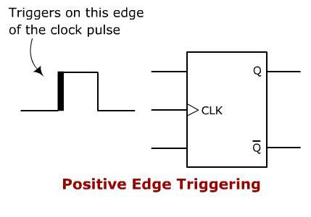
1.Edge triggering
The flip-flops which change their outputs only to corresponding to the positive (rising)or negative(falling) edge of the clock input of clock input are called as edge triggering.
Types-
i. Positive edge triggering-these flip-flop allow its outputs to change in responses to its inputs only at the instants corresponding to the rising edges of clock.
#Education with Values
Department of Computer Engineering School of Polytechnic and Skill Development

Slide 22
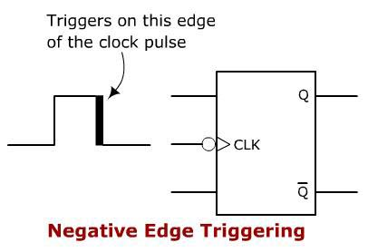
ii. Negative edge triggering- these flip-flop allow its outputs to change in responses to its inputs only at the instants corresponding to the falling edges of clock.
#Education with Values
Department of Computer Engineering School of Polytechnic and Skill Development

Slide 23
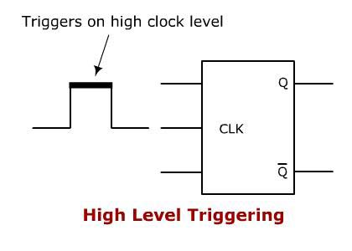
2.Level triggering
i.Positive Level triggering-
If outputs of a flip-flop responds to the input changes only when clock inputs at HIGH (1) is called positive level triggering.
#Education with Values
Department of Computer Engineering School of Polytechnic and Skill Development

Slide 24
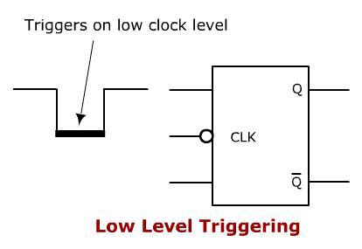
ii. Negative Level triggering
If outputs of a flip-flop responds to the input changes only when clock inputs at LOW(0) is called negative level triggering
#Education with Values
Department of Computer Engineering School of Polytechnic and Skill Development

Slide 25
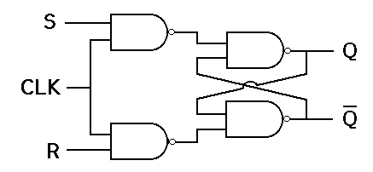
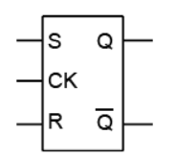
Clocked SR flip flops
Clock | Inputs |  | outputs
 | S | R | Qn+1
1 | 0 | 0 | Qn(no change)
1 | 0 | 1 | 0(Reset)
1 | 1 | 0 | 1(Set)
1 | 1 | 1 | forbidden
0 | 0 | 1 | No Change
#Education with Values
Department of Computer Engineering School of Polytechnic and Skill Development

Slide 26
Clocked SR flip flops
In this circuit if a clock pulses is present, its operation is same as normal SR flip flop,
But when the clock pulse is not present or is low then input to both gates is 0 which forces output of both gate to 1 irrespective of input S and R
#Education with Values
Department of Computer Engineering School of Polytechnic and Skill Development

Slide 27
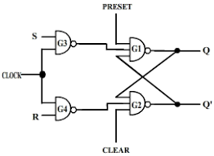
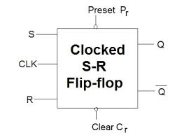
Clocked SR flip flop with preset and clear
Inputs |  |  | Output Q | Operation performed
Clock | Cr | Pr
0 | 0 | 1 | 0 | clear
0 | 1 | 0 | 1 | preset
#Education with Values
Department of Computer Engineering School of Polytechnic and Skill Development

Slide 28
Clocked SR flip flop with preset and clear
In many applications it is desired to initially set or reset the flip-flop. this is accomplished by using preset(Pr) and clear(Cr).
If Pr=Cr=1 then circuit operates in accordance with truth table of S-R flip-flop.
If Pr=0 and Cr=1 then the output of G1 will be Q=1 and three input to G2 will be make =0,hence making Pr=0 sets the flip flop.
Similarly if Pr=1 and Cr=0 then the flip flop is reset.
The condition Pr=Cr=0 must not be used, since this leads to uncertain state.
#Education with Values
Department of Computer Engineering School of Polytechnic and Skill Development

Slide 29
Drawbacks of SR flip flop
Both inputs should not be high when the cock is triggered .this is considered an invalid input condition and the resulting output is not predictable if this condition is occurred.
The uncertainty in the state of SR flip flop When S=R=1 ,can be eliminated by converting it to J-k flip flop.
#Education with Values
Department of Computer Engineering School of Polytechnic and Skill Development

Slide 30
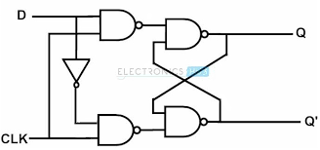
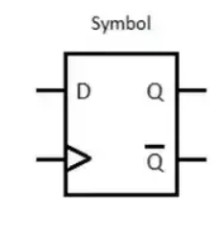
D-flip-flop
When S=R=0 or S=R=1, the outputs Q and Q’ either do not change or they are indeterminate (invalid)due to race condition, this disadvantages of S-R latch can be overcome by using the gated D latch.
CLK | input D | Output Q | Status
↑ | 0 | 0 | Reset
↑ | 1 | 1 | set
0 | ₓ | ₓ | No change
1 | ₓ | ₓ | No change
#Education with Values
Department of Computer Engineering School of Polytechnic and Skill Development

Slide 31
D-flip-flop
The D-flip flop is simple S-R flip-flop with inverter connected between its input s and R.
Due to inverter S and R will be the complements of each other. Hence S=R=0 OR S=R=1. this will avoid problem with SR=00and SR=11condition
When Clk=1, D=0 then S=0 ,R=1 Hence this will produce Q=0 .which willl reset the flip-flop
When Clk=1, D=1 then S=1 ,R=0 Hence this will produce Q=01.which will reset the flip-flop.
From the truth table it is concluded that Q output will follow D input.
There is no Race condition for this flip flop.
#Education with Values
Department of Computer Engineering School of Polytechnic and Skill Development

Slide 32
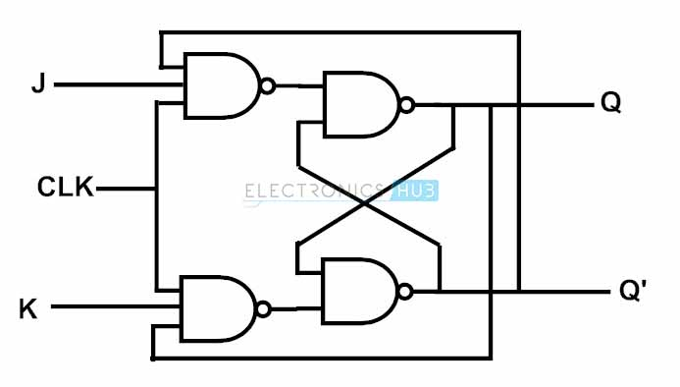
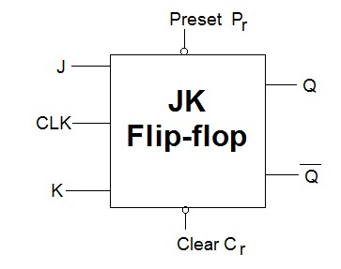
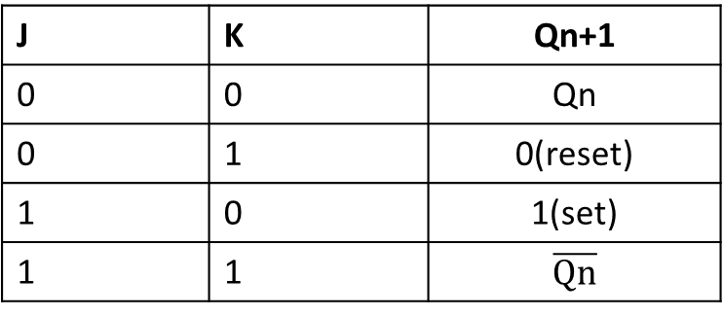
JK flip-flop
CLK | J | K | Qn+1
↑ | 0 | 0 | Qn
↑ | 0 | 1 | 0(reset)
↑ | 1 | 0 | 1(set)
↑ | 1 | 1
#Education with Values
Department of Computer Engineering School of Polytechnic and Skill Development

Slide 33
Construction of JK FF
J and K will be given as external inputs to S and R. As shown in the logic diagram, R’ and S’ will be the outputs of the combinational circuit.
The truth tables for the flip flop conversion are given below. The present state is represented by Qn and Qn+1 is the next state to be obtained when the J and K inputs are applied.
For two inputs J and K, there will be eight possible combinations. For each combination of J, K and Qn, the corresponding Qn+1 states are found. Qn+1 simply suggests the future values to be obtained by the JK flip flop after the value of Qn. The table is then completed by writing the values of S’ and R’required to get each Qn+1 from the corresponding Qn. That is, the values of S’ and R’ that are required to change the state of the flip flop from Qn to Qn+1 are written.
#Education with Values
Department of Computer Engineering School of Polytechnic and Skill Development

Slide 34
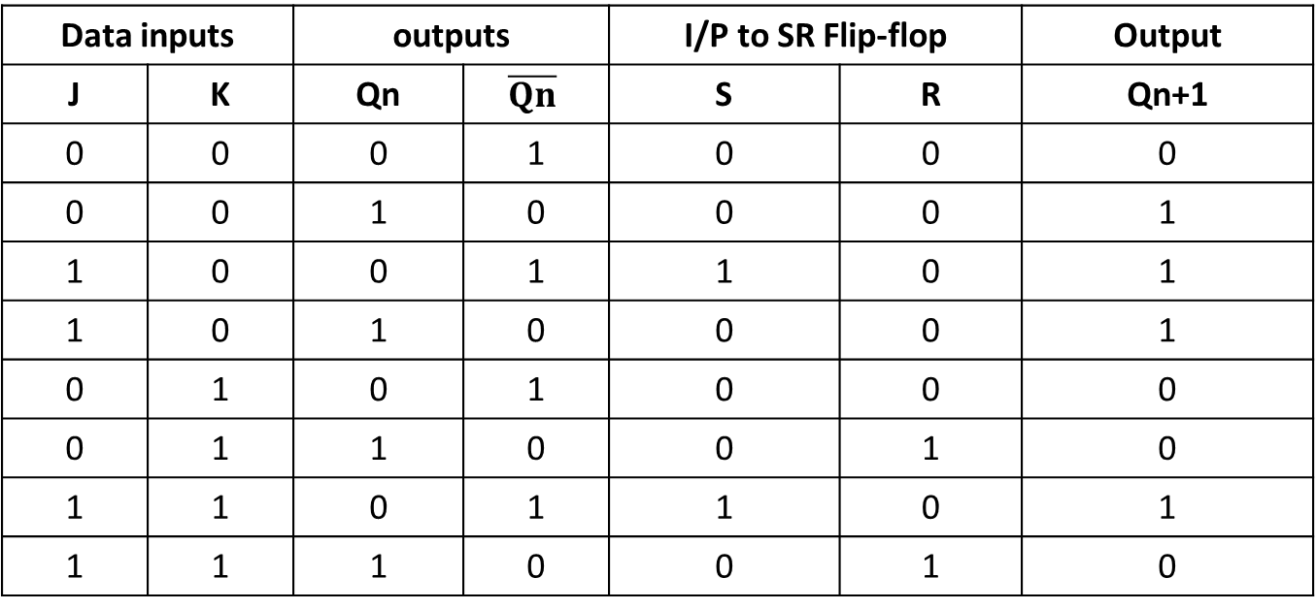
Truth table
Data inputs |  | Outputs(past) |  | I/P to SR Flip-flop |  | Output(present)
J | K | Qn |  | R’ | S’ | Qn+1
0 | 0 | 0 | 1 | 0 | 0 | 0
0 | 0 | 1 | 0 | 0 | 0 | 1
1 | 0 | 0 | 1 | 1 | 0 | 1
1 | 0 | 1 | 0 | 0 | 0 | 1
0 | 1 | 0 | 1 | 0 | 0 | 0
0 | 1 | 1 | 0 | 0 | 1 | 0
1 | 1 | 0 | 1 | 1 | 0 | 1
1 | 1 | 1 | 0 | 0 | 1 | 0
#Education with Values
Department of Computer Engineering School of Polytechnic and Skill Development

Slide 35
J-K FF Operation
When J=K=0 and clk=1 then output both NAND gates are S=1 and R=1 which are input to next NAND gate which retains previous output.
When J=0 ,K=1 , clk=1
This is ‘Reset’ state of Flip-Flop
3. When J=1 ,K=0 , clk=1
This is ‘set’ state of Flip-Flop
4. When J=1 ,K=1 , clk=1
This is ‘toggling’ state of Flip-Flop
#Education with Values
Department of Computer Engineering School of Polytechnic and Skill Development

Slide 36
D-flip-flop
CLK | input D | Output Q | Status
↑ | 0 | 0 | Reset
↑ | 1 | 1 | set
0 | ₓ | ₓ | No change
1 | ₓ | ₓ | No change
#Education with Values
Department of Computer Engineering School of Polytechnic and Skill Development

Slide 37
Race around condition
The ‘race around condition occurs when J=K=1.
If the clock pulse is of short duration then JKFF change its output to toggling state only once for the condition J=K=1 and it is allowed.
But clock pulse is of longer duration, then the output will change their state for more than one time. This is undesirable and called Race condition.
The multiple toggling in JK flip flop is called as RACE.
It can be avoided by using Master slave JK flip-flop.
#Education with Values
Department of Computer Engineering School of Polytechnic and Skill Development

Slide 38
T-flip flop
It is basically JK flip flop with J and k terminals permanently connected together.
It has only one input referred as T-input.
When T=0, J=k=0 output Q won’t cahnge.
But if T=1 then J=K=1 and the outputs will toggle corresponding to every leading edge of clock pulse.
#Education with Values
Department of Computer Engineering School of Polytechnic and Skill Development

Slide 39
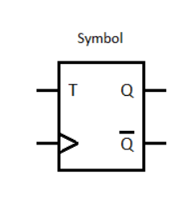
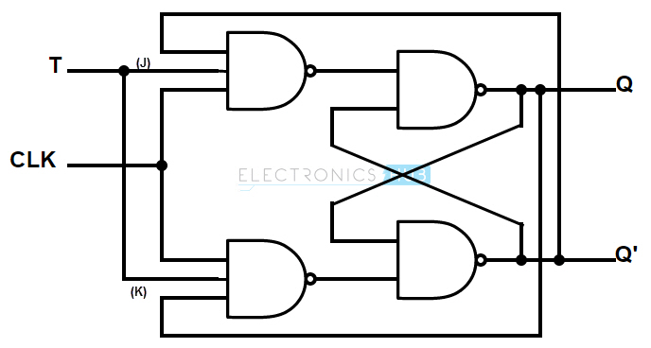
T-flip flop
CLK | T | Q | status
↑ | 0 | Qn | No change
↑ | 1 | Qn’ | toggle
#Education with Values
Department of Computer Engineering School of Polytechnic and Skill Development

Slide 40
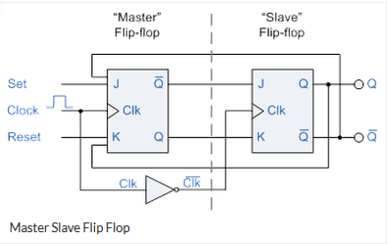
Master slave JK flip-flop
It is a combination of Clocked JK flip flop and clocked SR flip flop.
The Jk flip flop acts as the master and the clocked SR flip flop as slave.
Master is positive level triggered but due to presence of inverter in the clock ,the slave will respond to negative level.
When clock=1 the master is active and the slave is inactive. whereas when clock=0 the slave is active and the master is inactive
#Education with Values
Department of Computer Engineering School of Polytechnic and Skill Development

Slide 41
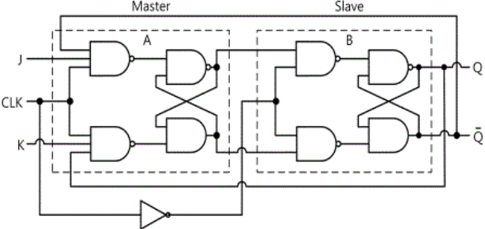
Master slave JK flip-flop
CLk | J | K | Q | status
↑ | 0 | 0 | Qn | No change
↑ | 0 | 1 | 0 | Reset
↑ | 1 | 0 | 1 | Set
↑ | 1 | 1 | Qn’ | Toggle
#Education with Values
Department of Computer Engineering School of Polytechnic and Skill Development

Slide 42
Master slave JK flip-flop
If J=1 and K=0 the master sets Q=1 on the positive clock edge. this Q=1 drives the J input of slave so when negative clock edge come the slave sets output Q=1, copying master.
If J=0 and K=1 the master resets Q’=1 on the positive clock edge. this Q’=1 drives the k input of slave so when negative clock edge come the slave resets output Q’=1, copying master.
If J=K=1 master toggles between 0 and 1 for positive clock, at the same time slave disable so toggling is avoided in M-S J-K flipflop.
#Education with Values
Department of Computer Engineering School of Polytechnic and Skill Development

Slide 43
Excitation table of flip flop
Truth table of flip flop is known as characteristic table.
While designing sequential ckt. Present and next state is given and we need to find corresponding input condition. For that we require excitation table.
Present state means , state prior to application of clock pulse and next state means the state after application of clock pulse.
#Education with Values
Department of Computer Engineering School of Polytechnic and Skill Development

Slide 44
Excitation table of SR flip flop
Present State of Q output | Next State of Q output | Sn input | Rn input
0 | 0 | 0 | ×
0 | 1 | 1 | 0
1 | 0 | 0 | 1
1 | 1 | × | 0
#Education with Values
Department of Computer Engineering School of Polytechnic and Skill Development

Slide 45
Excitation table of J K flip flop
Present State of Q output | Next State of Q output | Jn input | Kn input
0 | 0 | 0 | ×
0 | 1 | 1 | ×
1 | 0 | × | 1
1 | 1 | × | 0
#Education with Values
Department of Computer Engineering School of Polytechnic and Skill Development

Slide 46
Excitation table of D flip flop
Present State of Q output | Next State of Q output | Dn input
0 | 0 | 0
0 | 1 | 1
1 | 0 | 0
1 | 1 | 1
#Education with Values
Department of Computer Engineering School of Polytechnic and Skill Development

Slide 47
Excitation table of T flip flop
Present State of Q output | Next State of Q output | Tn input
0 | 0 | 0
0 | 1 | 1
1 | 0 | 1
1 | 1 | 0
#Education with Values
Department of Computer Engineering School of Polytechnic and Skill Development

Slide 48
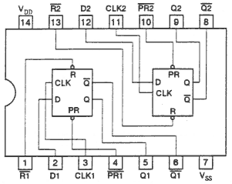
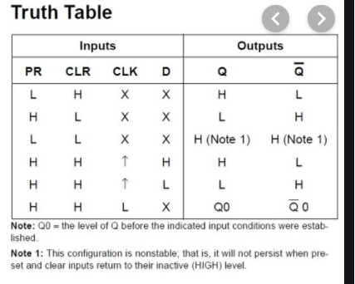
Flip flop IC 7474
It is a dual edge-triggered flip-flop which is based on schottky TTL circuitry to produce high speed D-type flipflops.
#Education with Values
Department of Computer Engineering School of Polytechnic and Skill Development

Slide 49
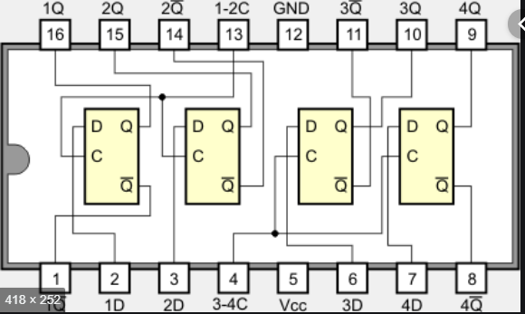
IC 7475
It is a dual four bit bistable latch. it consist of two four bit bistable latches.
The information present at a data input is transferred to the Q output when enable (c1 or c2)input is high. when enable input goes low the last present state is obtained at Q output.
D | C | Q | Q’
L | H | L | H
H | H | H | L
× | L | Qn | Qn’
#Education with Values
Department of Computer Engineering School of Polytechnic and Skill Development

Slide 50
Thank You
#Education with Values
Department of Computer Engineering School of Polytechnic and Skill Development

